Slide 1
LED issue report
Date: 17 Mar. 2021

Slide 2
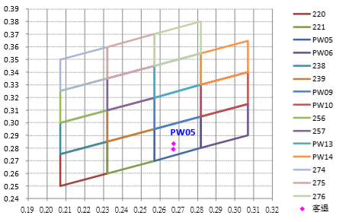

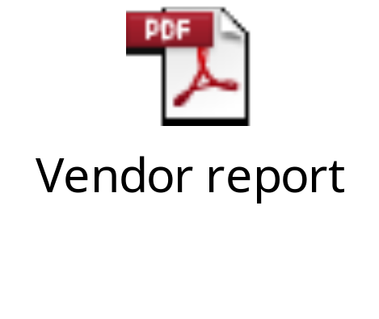
1-Nov-2019 Report for reddish LED
Description of the Problem :
1-Nov-2019,customer complain [BFX-AT100] , LED issue: 1/500pcs.
This defect belongs to bin code PW05 in specification with reddish color. Please see detail as bellow
Corrective Action:
1. In production process, we also found out the reddish LED and informed customer in the middle of October and had a summary report for this issue (as attached file “Mixed white LED issue” below).
2. We also sent two samples to vendor for further analysis.
3. The result was the reddish LED belongs to PW05 bin code within CIE bin grading specification (see picture and vendor report below).
1

Slide 3


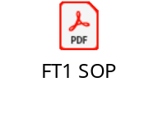
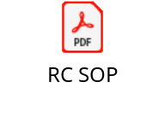
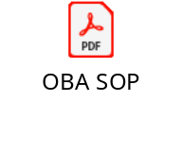
21-Jan-2021 Report for purple LED
Description of problem
21-Jan-2021 customer complained purple LED light from the field and the acceptance inspection.
Corrective Action
Line leader and operators on production line are trained about LED issue by abnormal LED defect image and how to deal with this issue. ( Quality Alert below)
In production process, all operators at test station follow SOP to inspect LED of product, and no find similar LED defect issue.
If operators find out abnormal, they will put LED defect in error product area and inform immediately with repairer to transfer for RE engineer and change new normal LED for product.
Function Test Station | FT Station | FT1 Station | RC Station | OBA Station
Quality Arlam training
SOP/SIP checking
Result | No defect issue | No defect issue | No defect issue | No defect issue

Slide 4
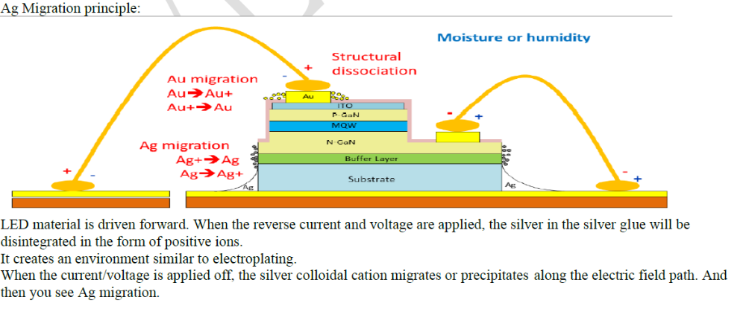
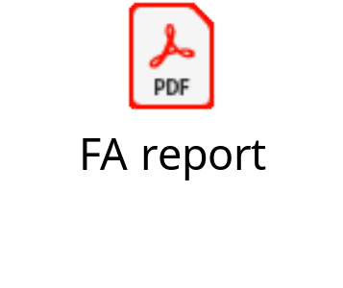
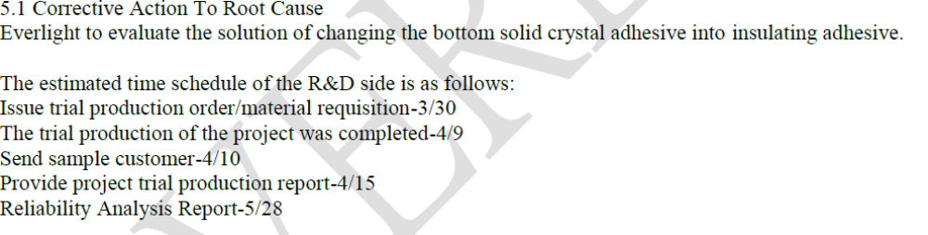
Vendor FA report

